Slide 1

Machine-Learning-Projects
Logistic Regression
Kernel Principal Components Analysis
Osama Bensoudane

Slide 2
Introduction
Les études multifactorielles sont utilisée en épidémiologie et en
recherche clinique
Objectifs :
Identifier les variables qui caractérisent les différentes catégories
Identifier les facteur de confusion.
Élaborer des scores prédictifs

Slide 3
Plan
Introduction
Régression logistique
Kernel Principal Components Analysis

Slide 4
Introduction
La régression logistique :
les deux valeurs possibles d’une variable binaire seront codées par 1 et 0
caractérise une relation entre une variable dépendante qualitative, et une ou plusieurs variables explicatives qualitatives ou quantitatives.
Elle a le même principe que celui de la régression linéaire.
les associations entre les covariables et la variable expliquée sont exprimées par les odds ratio

Slide 5
La régression logistique
Ordinary linear regression is used a lot, and is taught in every intro stat class. Logistic regression is rarely taught or even mentioned in intro stats, but mostly because of inertia.
We now have the computing power and software to implement logistic regression.
π = Proportion of “Success”
In ordinary regression the model predicts the mean Y for any combination of predictors.
What’s the “mean” of a 0/1 indicator variable?
Goal of logistic regression: Predict the “true” proportion of success, π, at any value of the predictor.

Slide 6
Binary Logistic Regression Model
Y = Binary response
X = Quantitative predictor
π = proportion of 1’s (yes,success) at any X
Equivalent forms of the logistic regression model:
Logit form
Probability form
What does this look like?
N.B.: This is natural log (aka “ln”)

Slide 7
La régression logistique

Slide 8
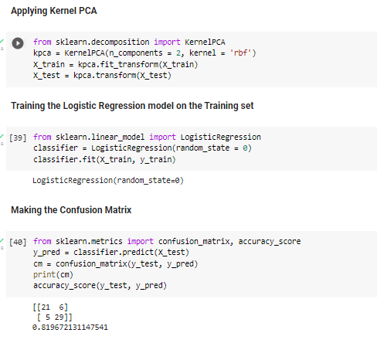
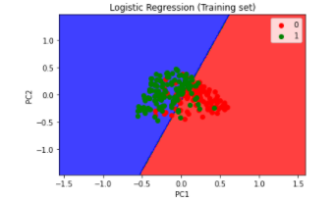
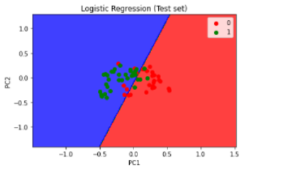
Kernel Principal Components Analysis
A last algorithm which uses kernels (more on the SVM lecture) will be given below. We simply summarise the algorithm.
This algorithm can be considered as a non-linear PCA methods as we first project the input space in a feature space using a non-linear transform ϕ(x) and then we perform a linear PCA analysis in the feature space. This is different from the previous methods in that they calculate a linear transformation between the input and the feature spaces.

Slide 9
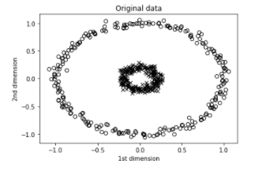
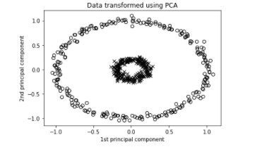
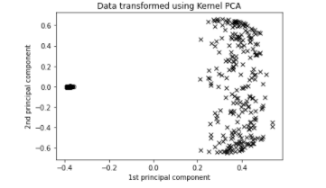
Kernel Principal Components Analysis and Principal Components Analysis

Slide 10
Kernel Principal Components Analysis and Principal Components Analysis
PCA is a linear method. That is it can only be applied to datasets which are linearly separable. ... Kernel PCA uses a kernel function to project dataset into a higher dimensional feature space, where it is linearly separable.

Slide 11
Conclusion

